Slide 1
Comparator

Slide 2
Two-Bit Comparator
A B C D LT EQ GT
0 0 0 0 0 1 0
0 1 1 0 0
1 0 1 0 0
1 1 1 0 0
0 1 0 0 0 0 1
0 1 0 1 0
1 0 1 0 0
1 1 1 0 0
1 0 0 0 0 0 1
0 1 0 0 1
1 0 0 1 0
1 1 1 0 0
1 1 0 0 0 0 1
0 1 0 0 1
1 0 0 0 1
1 1 0 1 0
N1
A
LT
EQ
GT
A B < C D
A B = C D
A B > C D
B
N2
C
D
block diagram
and
truth table
we'll need a 4-variable Karnaugh map
for each of the 3 output functions

Slide 3
Two-Bit Comparator (cont’d)
A
A
A
0 0
1 0
0 0
0 0
1 0
0 1
0 0
0 0
0 1
0 0
1 1
1 1
D
D
D
1 1
1 1
0 1
0 0
0 0
0 0
1 0
0 1
0 0
0 0
0 0
1 0
C
C
C
B
B
B
K-map for LT
K-map for EQ
K-map for GT
LT =
EQ =
GT =
A' B' D + A' C + B' C D
A'B'C'D' + A'BC'D + ABCD + AB'CD’
= (A xnor C) • (B xnor D)
B C' D' + A C' + A B D'

Slide 4
Equality Comparator
XNOR
X Y Z
0 0 1
0 1 0
1 0 0
1 1 1
X
Z
Y
Z = X XNOR Y

Slide 5
4-bit Equality Detector
A[3..0]
Equality
Detector
A_EQ_B
B[3..0]

Slide 6
4-Bit Equality Comparator
A0
C0
B0
A1
C1
B1
A_EQ_B
A2
B2
C2
A3
B3
C3

Slide 7
4-bit Magnitude Comparator
A_LT_B
A[3..0]
Magnitude
Detector
A_EQ_B
B[3..0]
A_GT_B

Slide 8
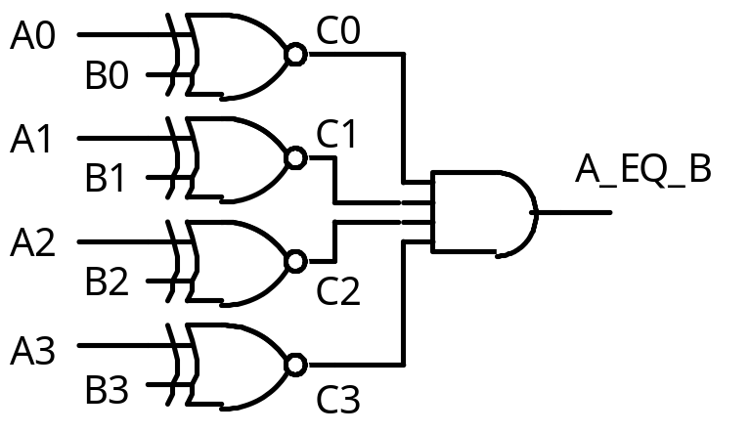
Magnitude Comparator
How can we find A_GT_B?
How many rows would a truth table have?
2⁸ = 256!

Slide 9
Magnitude Comparator
Find A_GT_B
Because A3 > B3
i.e. A3 . B3’ = 1
If A = 1001 and
B = 0111
is A > B?
Why?
Therefore, one term in the
logic equation for A_GT_B is
A3 . B3’

Slide 10
Magnitude Comparator
A_GT_B = A3 . B3’
+ …..
Because A3 = B3 and
A2 > B2
i.e. C3 = 1 and
A2 . B2’ = 1
If A = 1101 and
B = 1011
is A > B?
Why?
Therefore, the next term in the
logic equation for A_GT_B is
C3 . A2 . B2’

Slide 11
Magnitude Comparator
A_GT_B = A3 . B3’
+ C3 . A2 . B2’
+ …..
Because A3 = B3 and
A2 = B2 and
A1 > B1
i.e. C3 = 1 and C2 = 1 and
A1 . B1’ = 1
If A = 1010 and
B = 1001
is A > B?
Why?
Therefore, the next term in the
logic equation for A_GT_B is
C3 . C2 . A1 . B1’

Slide 12
Magnitude Comparator
A_GT_B = A3 . B3’
+ C3 . A2 . B2’
+ C3 . C2 . A1 . B1’
+ …..
Because A3 = B3 and
A2 = B2 and
A1 = B1 and
A0 > B0
i.e. C3 = 1 and C2 = 1 and
C1 = 1 and A0 . B0’ = 1
If A = 1011 and
B = 1010
is A > B?
Why?
Therefore, the last term in the
logic equation for A_GT_B is
C3 . C2 . C1 . A0 . B0’

Slide 13
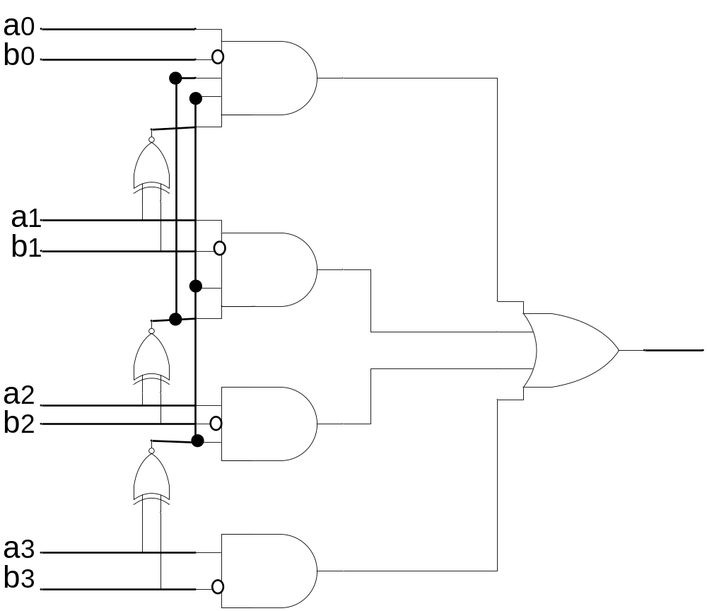
Magnitude Comparator
A_GT_B = A3 . B3’
+ C3 . A2 . B2’
+ C3 . C2 . A1 . B1’
+ C3 . C2 . C1 . A0 . B0’

Slide 14
Magnitude Comparator
Find A_LT_B
A_LT_B = A3’ . B3
+ C3 . A2’ . B2
+ C3 . C2 . A1’ . B1
+ C3 . C2 . C1 . A0’ . B0

Slide 15
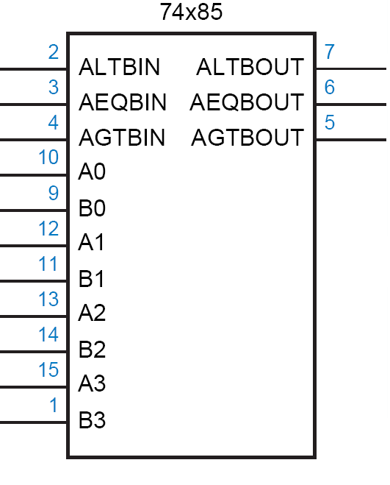
TTL 74x85
4
A
4
B
lt
l
eq
e
gt
g

Slide 16
TTL 74x85
  if (A>B) lt=0, eq=0, gt=1
  if (A<B) lt=1, eq=0, gt=0
  if (A=B) lt=l, eq=e, gt=g
  The three l, e and g inputs are used when cascading.
4
A
4
B
lt
l
eq
e
gt
g

Slide 17
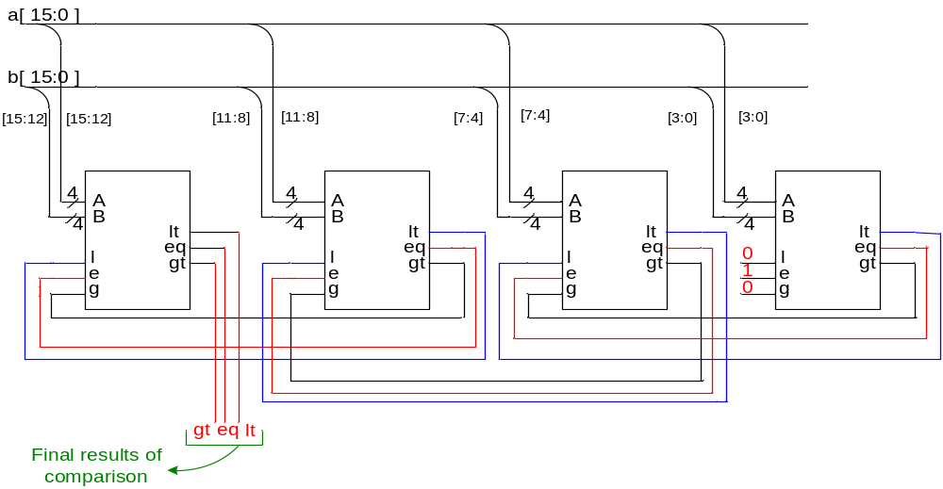
Comparator (continued…)
  Let us now cascade four of the 74x85 to construct a 16 bit comparator.
Exercise: Analyze it.

Slide 18
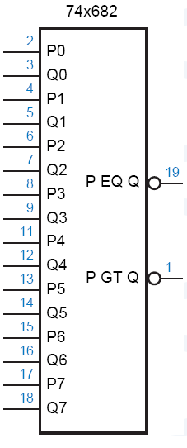
TTL 74x682
  8-bit Comparator
    Arithmetic conditions derived from 74x682 outputs?
    And their circuits?

Slide 19
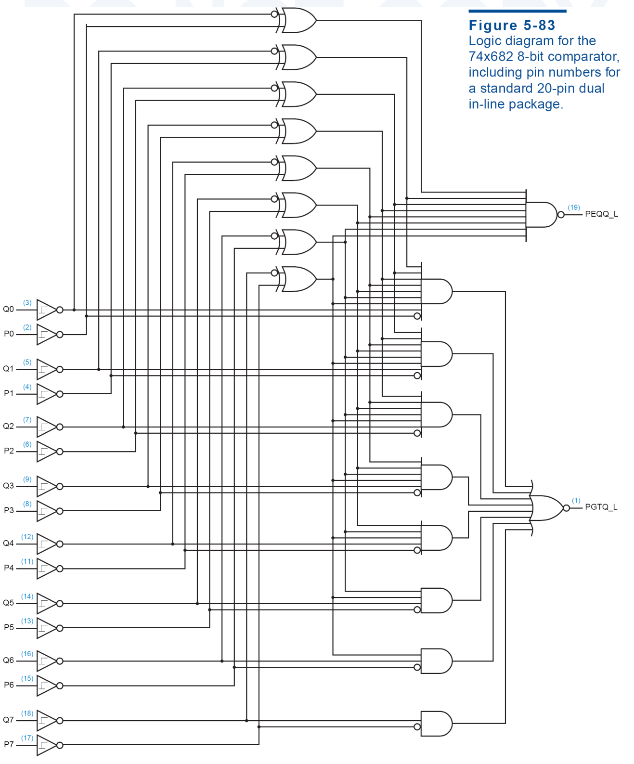

Slide 20
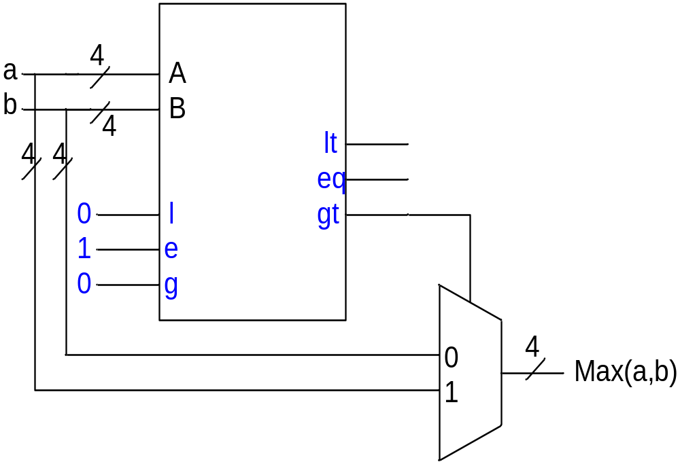
Maximum Finder
Design a maximum finder
a
4
b
4

Slide 21
Adder

Slide 22
Adder
Review 01_numbers.ppt

Slide 23
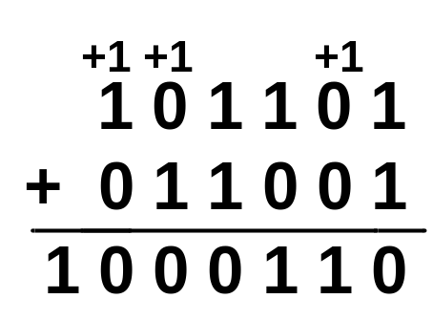
اعمال رياضي باينري: جمع
قوانين: مانند جمع دسيمال
با اين تفاوت که1+1 = 10 ← توليد نقلي
  0+0 = 0c0 (sum 0 with carry 0)
  0+1 = 1+0 = 1c0
  1+1 = 0c1
  1+1+1 = 1c1
Carry | 1 | 1 | 1 | 1 | 1 | 0
Augend | 0 | 0 | 1 | 0 | 0 | 1
Addend | 0 | 1 | 1 | 1 | 1 | 1
Result | 1 | 0 | 1 | 0 | 0 | 0

Slide 24
نمايش اعداد
n
N* = 2 - N
4
2 = 10000
7 = 0111
1001 = repr. of -7
مکمل 2:
Example: Twos complement of 7
sub
4
Example: Twos complement of -7
2 = 10000
-7 = 1001
0111 = repr. of 7
sub
Shortcut method:
Twos complement = bitwise complement + 1
0111 -> 1000 + 1 -> 1001 (representation of -7)
1001 -> 0110 + 1 -> 0111 (representation of 7)

Slide 25
جمع و تفريق
مکمل 2
4
+ 3
7
0100
0011
0111
-4
+ (-3)
-7
1100
1101
11001
If
)carry-in to sign = carry-out (
then ignore carry
if
)carry-in ≠ carry-out(
then overflow
4
- 3
1
0100
1101
10001
-4
+ 3
-1
1100
0011
1111
Simpler addition scheme makes twos complement the most common
choice for integer number systems within digital systems

Slide 26
سرريز
Overflow Conditions
Add two positive numbers to get a negative number
or two negative numbers to get a positive number
-1
+0
-1
+0
-2
1111
0000
+1
-2
1111
0000
+1
-3
1110
0001
-3
1110
0001
1101
+2
1101
+2
-4
0010
-4
0010
1100
0011
+3
1100
0011
+3
-5
1011
-5
0100
+4
1011
0100
+4
-6
1010
-6
1010
0101
+5
0101
+5
1001
0110
1001
0110
-7
1000
+6
-7
+6
0111
1000
0111
-8
+7
-8
+7
5 + 3 = -8
-7 - 2 = +7

Slide 27
سرريز
Overflow Conditions
0 1 1 1
0 1 0 1
0 0 1 1
1 0 0 0
1 0 0 0
1 0 0 1
1 1 0 0
1 0 1 1 1
5
3
-8
-7
-2
7
Overflow
Overflow
0 0 0 0
0 1 0 1
0 0 1 0
0 1 1 1
1 1 1 1
1 1 0 1
1 0 1 1
1 1 0 0 0
5
2
7
-3
-5
-8
No overflow
No overflow
Overflow when carry in to sign ≠ carry out

Slide 28
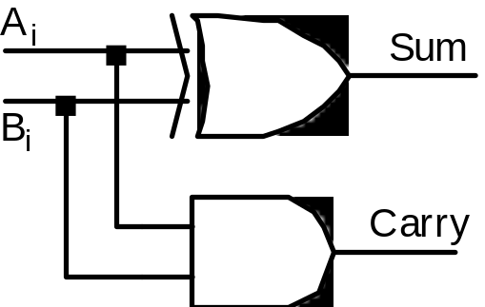
Half Adder (HA)
  Add single bits
Ai
0
1
Ai
0
1
Ai
Bi
Sum
Carry
Bi
Bi
0
0
0
0
0
0
1
0
0
0
0
1
1
0
1
0
1
0
1
1
0
1
0
1
1
1
0
1
Sum = Ai Bi + Ai Bi
Carry = Ai . Bi
= Ai⊕Bi

Slide 29
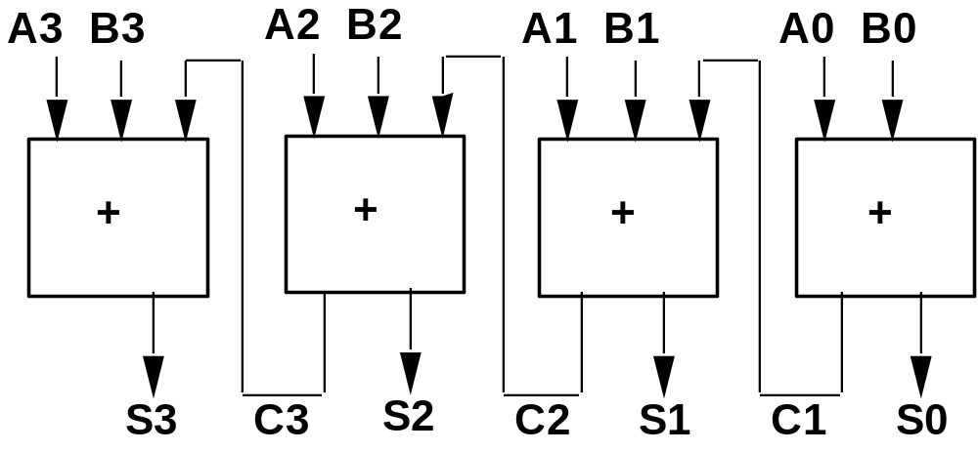
Full Adder
  Add multiple bits

Slide 30
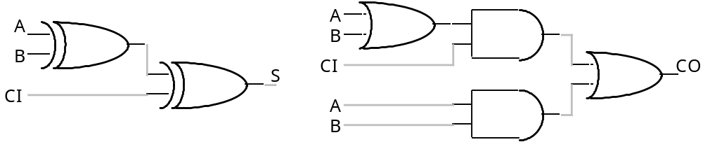
Full Adder (FA)
A B
A
B
C_{I}
S
C_{O}
C_{I}
00
01
11
10
0
0
0
0
0
0
0
1
0
1
0
0
1
1
0
S
0
1
0
1
0
1
1
0
1
0
0
1
1
0
1
1
0
0
1
0
1
0
1
0
1
A B
1
1
0
0
1
C_{I}
00
01
11
10
1
1
1
1
1
0
0
0
1
0
C_{O}
S = C_{I} xor A xor B
C_{O} = B C_{I} + A C_{I} + A B = C_{I} (A + B) + A B
1
0
1
1
1

Slide 31
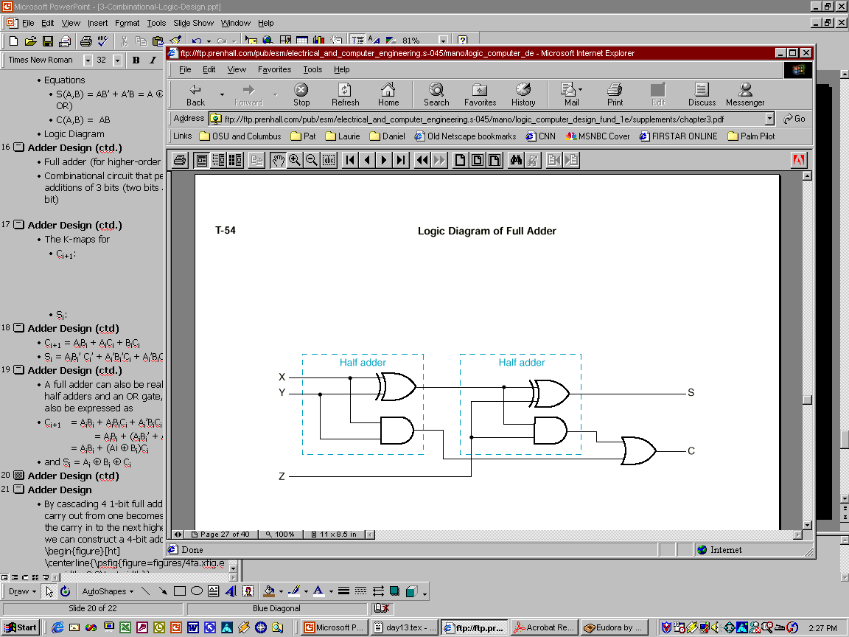
Full Adder Using 2 Half Adders
  A full adder can also be realized with two half adders and an OR gate, since C_{i+1} can also be expressed as:
  C_{i+1} = A_{i}B_{i} + (Ai ⊕ B_{i})C_{i}
  and S_{i} = (A_{i} ⊕ B_{i}) ⊕ C_{i}
A_{i}
B_{i}
S_{i}
C_{i+1}
C_{i}

Slide 32
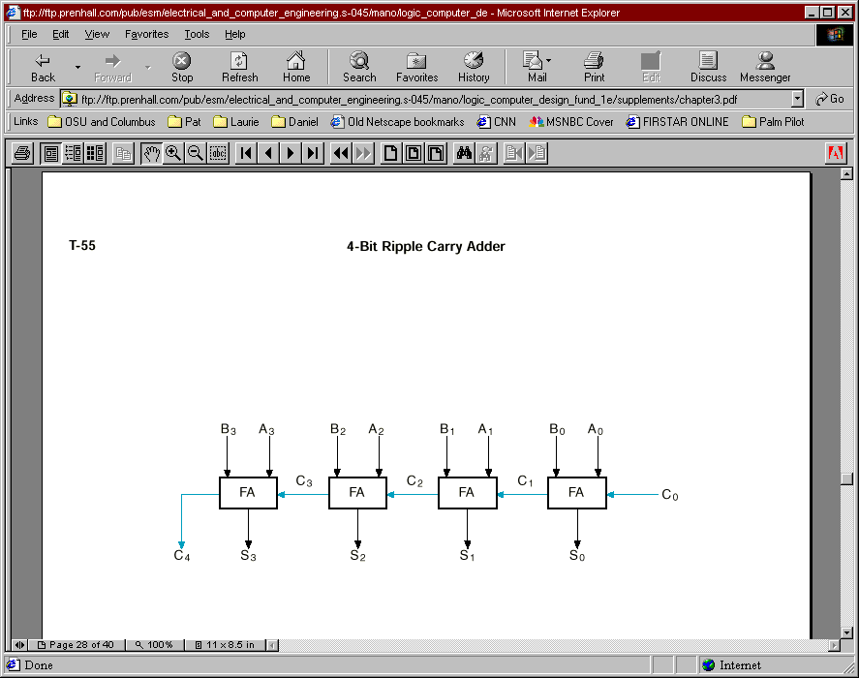
Example: 4-bit Ripple Carry Adder
C₄ C3 C2 C1 C0
A3 A2 A1 A0
+B3 B2 B1 B0
--------------
S3 S2 S1 S0

Slide 33
Delay Analysis of Ripple Adder
  Carry out of a single stage can be implemented in 2 gate delays after CI is ready.
  For a 16 bit adder, the 16th bit carry is generated after about 16 * 2 = 32 gate delays.
  The sum bit takes one additional gate delay to generate the sum of the 16th bit after 15th bit carry
    ~ 15 * 2 + 1 = 31 gate delays
  Takes too long - need to investigate FASTER adders!

Slide 34
Delay Analysis of Ripple Adder
late
arriving
signal
@0
A
@1
@N+1
@0
B
@N
CI
CO
@0
A
@N+2
two gate delays
to compute CO
@0
B
@1
C
0
A
0
S
@2
@0
A
0
0
B
C
@3
@0
B
4 stage
adder
0
1
S
A
1
S
@4
@N
CI
@N+1
1
1
B
C
@5
1
2
A
2
S
@6
2
2
B
C
@7
2
3
A
3
S
3
@8
B
3
C
@9
3
4

Slide 35
Carry Lookahead Adder
Carry Generate
  Gi = Ai Bi must generate carry when A = B = 1
Carry Propagate
  Pi = Ai xor Bi carry-in will equal carry-out here
Sum and Carry can be reexpressed in terms of generate/propagate:
Si = Ai xor Bi xor Ci = Pi xor Ci
Ci+1 = Ai Bi + Ai Ci + Bi Ci
= Ai Bi + Ci (Ai + Bi)
= Ai Bi + Ci (Ai xor Bi)
= Gi + Ci Pi

Slide 36
Carry Lookahead Adder
C1 = G0 + P0 C0
C2 = G1 + P1 C1
= G1 + P1 (G0 + P0 C0)
= G1 + P1 G0 + P1 P0 C0
C3 = G2 + P2 C2
= G2 + P2 (G1 + P1 G0 + P1 P0 C0)
= G2 + P2 G1 + P2 P1 G0 + P2 P1 P0 C0
C4 = G3 + P3 C3
= G3 + P3 G2 + P3 P2 G1 + P3 P2 P1 G0 + P3 P2 P1 P0 C0
  Each of the carry equations can be implemented in a two-level logic network
  Variables are the adder inputs and carry in to stage 0!

Slide 37
CLA
@0
Ai
@0
Bi
Pi
@1
Ci
Si
@t+1
@t
Gi
@1
C0
C0
C0
P0
C1
P0
P0
G0
P1
P1
P2
P2
G0
P3
C0
P1
G0
P0
P2
P1
P1
P2
G1
C3
P3
G0
C2
P2
G1
P1
P2
G2
P3
G1
G2
C4
P3
G3
  Increasingly complex logic

Slide 38
Delay Analysis of CLA
  Ci’s are generated independent of N
C
@0
Ai
0
@1
@0
Bi
Pi
A
S
@2
@t+1
0
0
0
@t
Ci
Si
B
0
C
@3
@1
1
Gi
A
S
@4
C0
1
1
1
P0
B
C
@3
P1
1
2
P2
4 stage
adder
G0
A
S
@4
P1
2
2
2
P2
B
C
@3
G1
C3
2
3
P2
A
G2
3
S
3
@4
B
3
C
@3
final sum and
carry
3
4
  NOTE: This assumes all gate delay are same.
  Not true, delays depend on fan-ins and fan-out

Slide 39
Cascaded CLA
CLA
CLA
CLA

Slide 40
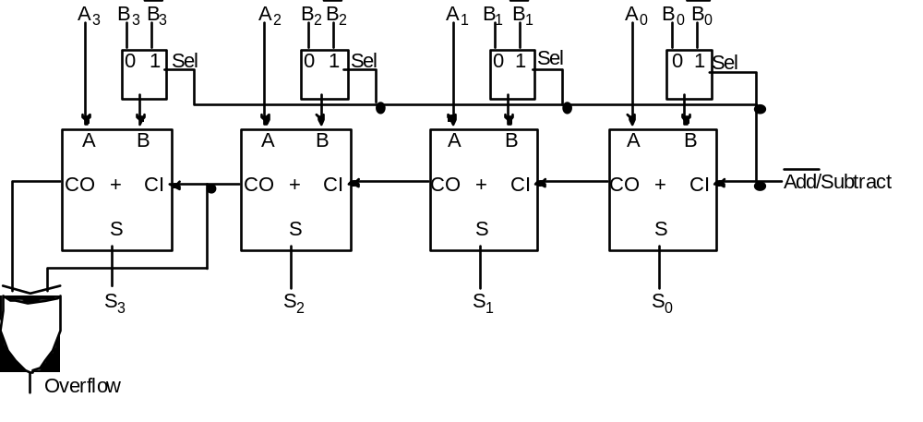
Adder/Subtractor
A - B = A + (-B) = A + B’ + 1

Slide 41
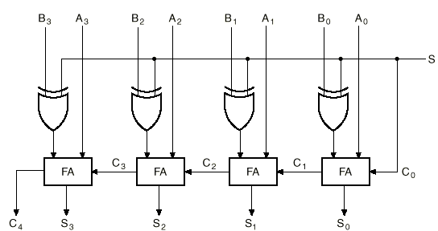
4-bit Binary Adder/Subtractor (cont.)
S=0
B₃
B₂
B₁
B₀
0
S=0 selects addition

Slide 42
4-bit Binary Adder/Subtractor (cont.)
S=1
B₃’
B₂’
B₁’
B₀’
1
S=1 selects subtraction

Slide 43
Overflow
  Overflow can occur ONLY when both numbers have the same sign.
  This condition can be detected when the carry out (C_{n}) is different than the carry at the previous position (C_{n-1}).

Slide 44
The Overflow problem in
Signed-2’s Complement (cont.)
Example 1: M=65₁₀ and N=65₁₀ (In an 8-bit 2’s complement system).
  M = N = 01000001₂
  M+N = 10000010 with C_{n}=0. (clearly wrong!)
  Bring C_{n} as the MSB to get 010000010₂ (130₁₀) which is correct, but requires 9-bits → overflow occurs.
Example 2: M=-65₁₀ and N=-65₁₀
  M = N = 10111111₂
  M+N = 01111110 with C_{n}=1. (wrong again!)
  Bring C_{n} as the MSB to get 101111110₂ (-130₁₀) which is correct, but also requires 9-bits → overflow occurs.

Slide 45
Overflow Detection in
Signed-2’s Complement
V
C_{n-1}
C_{n}
C
n-bit Adder/Subtractor
C =1 indicates overflow condition when adding/subtr. unsigned numbers.
V=1 indicates overflow condition when adding/subtr. signed-2’s
complement numbers

Slide 46
2x2-bit Multiplier
A2 A1 B2 B1 P8 P4 P2 P1
0 0 0 0 0 0 0 0
0 1 0 0 0 0
1 0 0 0 0 0
1 1 0 0 0 0
0 1 0 0 0 0 0 0
0 1 0 0 0 1
1 0 0 0 1 0
1 1 0 0 1 1
1 0 0 0 0 0 0 0
0 1 0 0 1 0
1 0 0 1 0 0
1 1 0 1 1 0
1 1 0 0 0 0 0 0
0 1 0 0 1 1
1 0 0 1 1 0
1 1 1 0 0 1
A1
A2
B1
B2
P1
P2
P4
P8
4-variable K-map
for each of the 4
output functions

Slide 47
2x2-bit Multiplier (cont’d)
A2
A2
K-map for P8
K-map for P4
0 0
0 0
0 0
0 0
0 0
0 0
0 0
0 0
P4 = A2B2B1'
+ A2A1'B2
B1
B1
0 0
0 0
1 0
0 0
0 0
0 0
0 1
1 1
B2
P8 = A2A1B2B1
B2
A1
A1
A2
A2
K-map for P2
K-map for P1
0 0
0 0
0 0
1 1
0 0
0 1
0 0
1 0
P1 = A1B1
B1
B1
0 1
0 1
0 1
1 0
0 1
0 0
1 0
0 0
B2
P2 = A2'A1B2
+ A1B2B1'
+ A2B2'B1
+ A2A1'B1
B2
A1
A1

Slide 48
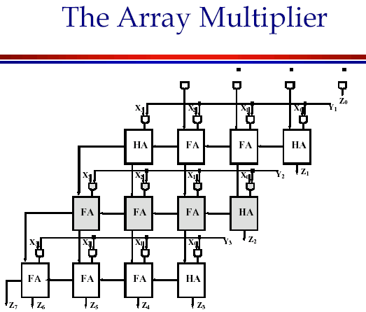

Multiplier
Y0
X3 Y3
X3 Y2
X2 Y3
X3 Y1
X2 Y2
X1 Y3
X3
Y3
X2 Y0
X2 Y1
X1 Y2
X0 Y3
X2
Y2
X2 Y0
X1 Y1
X0 Y2
X1
Y1
X1 Y0
X0 Y1
X0
Y0
X0 Y0
Z7
Z6
Z5
Z4
Z3
Z2
Z1
Z0

Slide 49
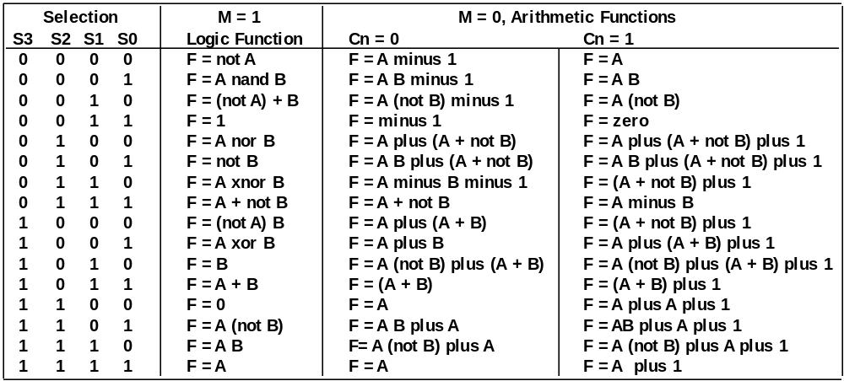
4-Bit ALU
74181 TTL ALU
  Arithmetic-Logic Unit

Slide 50
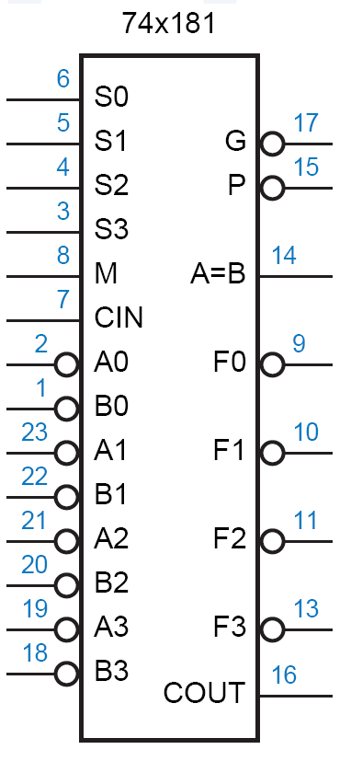
4-Bit ALU

Slide 51
BCD Addition
Addition:
5 = 0101
3 = 0011
1000 = 8
5 = 0101
8 = 1000
1101 = 13!
Problem
when digit
sum exceeds 9
Solution: add 6 (0110) if sum exceeds 9!
5 = 0101
8 = 1000
1101
6 = 0110
1 0011 = 1 3 in BCD
9 = 1001
7 = 0111
1 0000 = 16 in binary
6 = 0110
1 0110 = 1 6 in BCD

Slide 52
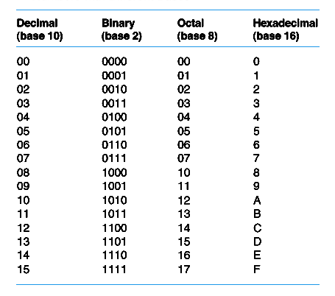
اعداد در مبناهاي مختلف
Add 0110 to sum whenever it exceeds 1001 (11XX or 1X1X)

Slide 53



BCD Adder
A
3
B
3
A
2
B
A
B
A
B
2
1
1
0
0
CO
F
A
CI
CO
F
A
CI
CO
F
A
CI
CO
F
A
CI
Cin
S
S
S
S
1
1XX
A1
1X1X
A2
CO
F
A
CI
CO
F
A
CI
0
S
S
Cout
S
S
S
S
3
2
1
0
Add 0110 to sum whenever it exceeds 1001 (11XX or 1X1X)

